Slide 1
All Saints CE First School – Pre-School
‘Every Day We Learn Through Play’
From age 2+

Slide 2
Who are we?
Founded in 1980, in the village hall, by mums wanting to meet up with children and enjoy a cuppa 1 morning per week.
Now based within All Saints CE First School….
All staff are DBS checked and qualified in childcare.
We follow the Early Years Foundation Stage Curriculum and promote ‘Learning through Play’.
Sessions are planned around childrens learning needs.
Staff lead activities where necessary but the children lead most with their imaginative play opportunities.

Slide 3
What do we offer?
For 2/3 & 4 year olds
Full or half day sessions, Monday to Friday
Half days can include dinner
Breakfast and afterschool club available for longer hours
15/30 hours funded *terms apply if eligible
Please enquire for our current availability

Slide 4
What is the curriculum?
Children ‘learn through play’
All activities are planned around the Early Years Foundation Stage Curriculum
Activities are judged against ‘learning outcomes’ in 7 areas
Communication and Language
Personal, Social & Emotional Development
Literacy
Mathematics
Understanding The World
Expressive Arts and Design
Physical Development

Slide 5
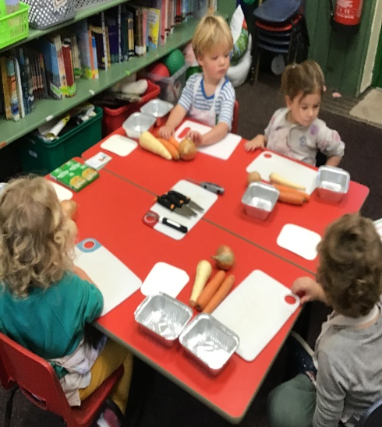
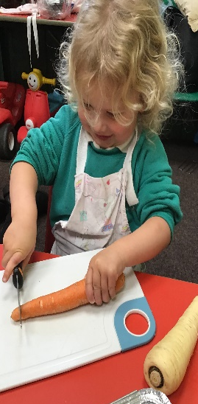
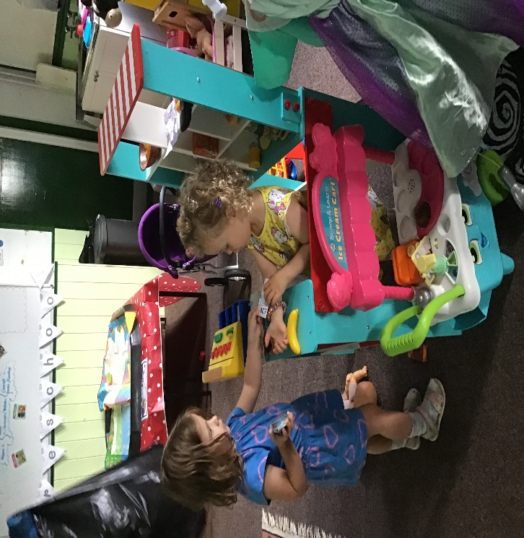
Our children meet the curriculum without knowing as they ‘learn through play’

Slide 6
What else can we offer?
WHOLE SCHOOL CELEBRATION ASSEMBLIES
TRANSITION DAYS
Opportunities to spend time with children from all years, in a weekly celebration assembly, singing and presenting our ‘Star of the week’ certificates.
Also sports days, mothers/fathers day celebrations and many more!!
Every child will have the opportunity to complete a transition day when they move from the 2 year room to the Nursery classroom.
Transitions over the years have been more successful for the children as they already know the children and the school, making it much less daunting.

Slide 7
Why does attending our preschool work?
Children get the opportunity to learn through play and hit curriculum milestones without knowing
They learn in a safe and nurturing environment
Small enough to not be overwhelming but big enough to provide opportunities
Based in the school setting, children ‘know’ what to expect, making transitions much easier
Children form lifelong friends from an early age

Slide 8
Contact Details
Address:
Church Leigh Preschool
c/o All Saints CE First School,
School Lane,
Church Leigh,
Stoke on Trent, Staffs. ST10 4SR
Tel: 01889 502289
Email: office@allsaints-leigh.staffs.sch.uk
We would love to meet you……
Book in today to come and have a look around and play with us!!

